Slide 1


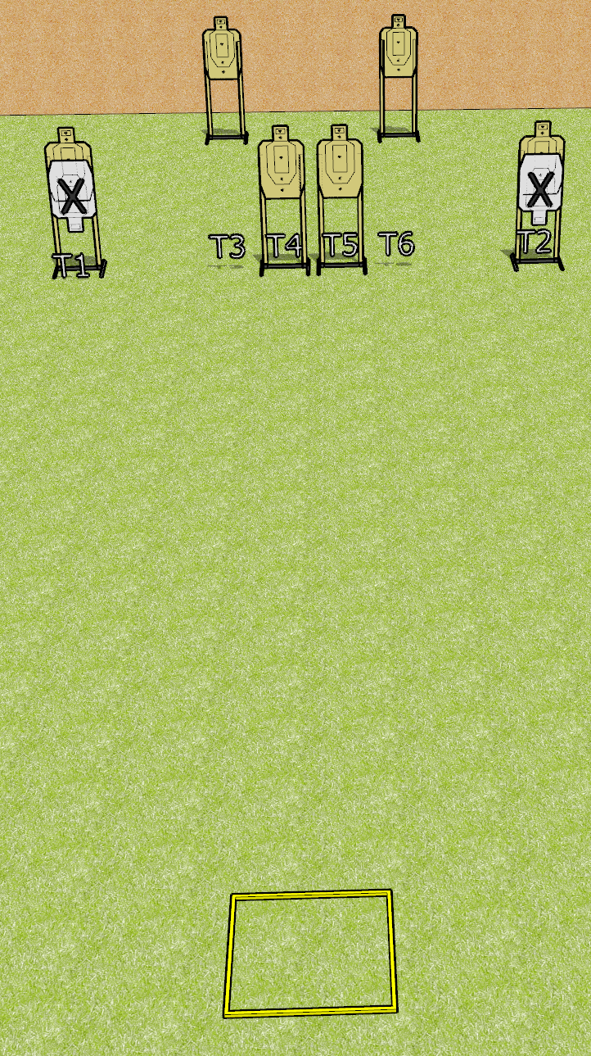
 | Dothan Gun Club – USPSA Match Count Your Rounds Course Designer : Drew Coleman
Round Count 12 rounds 6 USPSA
Equipment List Shooting box

Slide 2
Count Your Rounds
Written Stage Briefing
Scoring: Virginia Count
Targets: 6 USPSA
Rounds: 12
Handgun start position: anywhere inside the shooting area, facing uprange, wrists above shoulders. Handgun is loaded and holstered.
PCC start position: anywhere inside the shooting area, wrists above shoulders. Loaded carbine is held with both hands, safety on.
Stage Procedure: on the audible start signal engage T1-T2 OR T3, T4, T5, T6, perform a mandatory reload and engage the remaining array WEAK HAND ONLY (PCC WEAK SHOULDER ONLY).
Rules Note, Facing Uprange:
Face and feet pointing directly (180 degrees) away from the
backstop with shoulders and hips square to the backstop. A natural, "toes out" stance is acceptable and meets the standard of feet pointing directly away from the backstop, as long as both feet do not point in the same direction, and the rest of the position requirements are satisfied

Slide 3
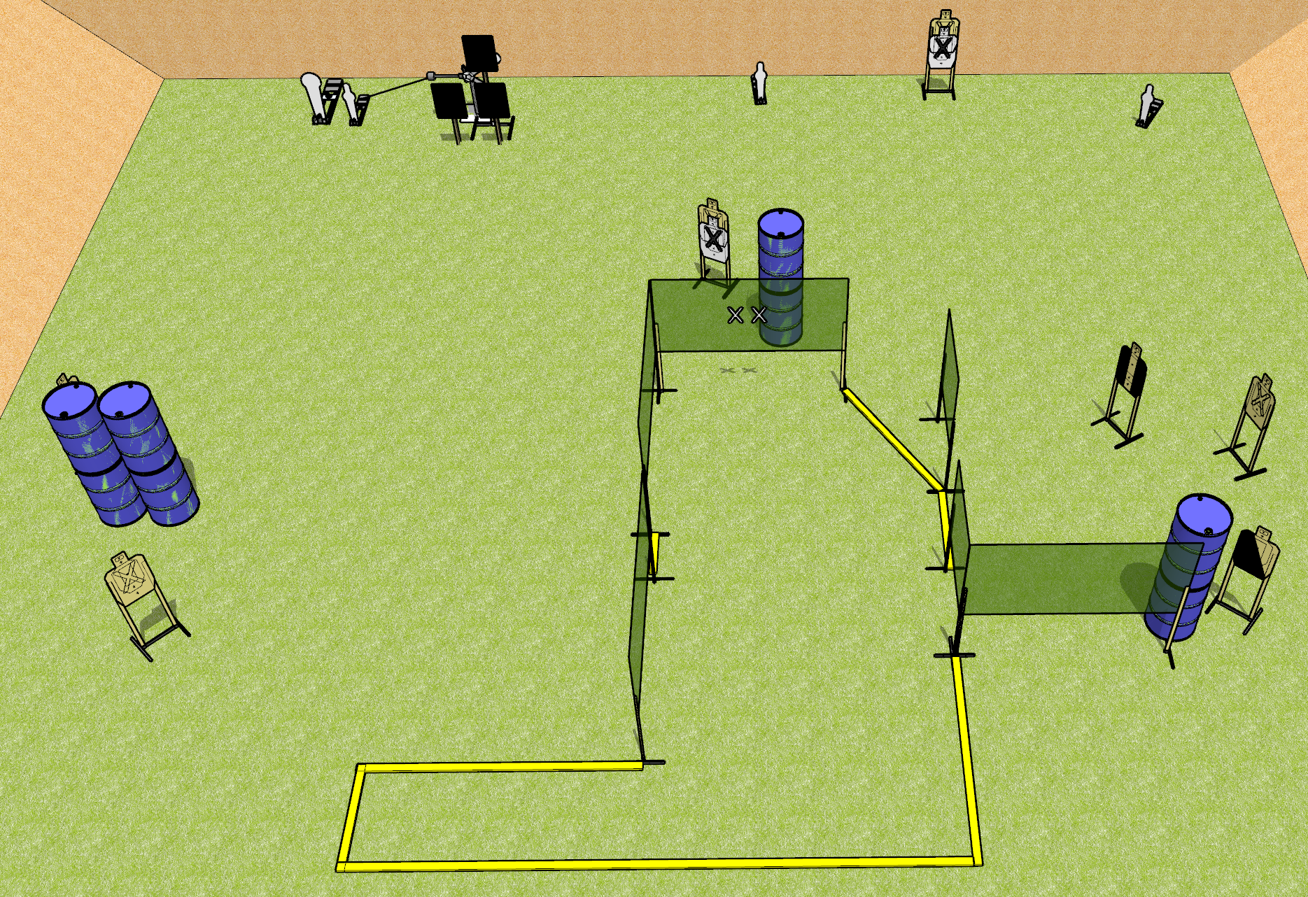
 | Dothan Gun Club – USPSA Match Crushin It Course Designer : Keanu Sy
Round Count 20 rounds 7 USPSA 1 colt, 3 mini, 2 plates
Equipment List 10 wall feet Red stitch + hard cover plates and stands (x3) 1 tux, 2 left diag, 6 targets (4 + 2NS)

Slide 4
Crushin It
Written Stage Briefing
Scoring: Comstock
Rounds: 20
Targets: 7 USPSA, 6 steel
Handgun start position: hands touching upper marks. Handgun is loaded and holstered.
PCC start position: muzzle touching lower mark, stock on belt. Carbine is loaded, safety on.
Stage Procedure: on the audible start signal, engage targets as they become available from within the shooting area. The swinger is activated by P2 and remains visible at rest.

Slide 5
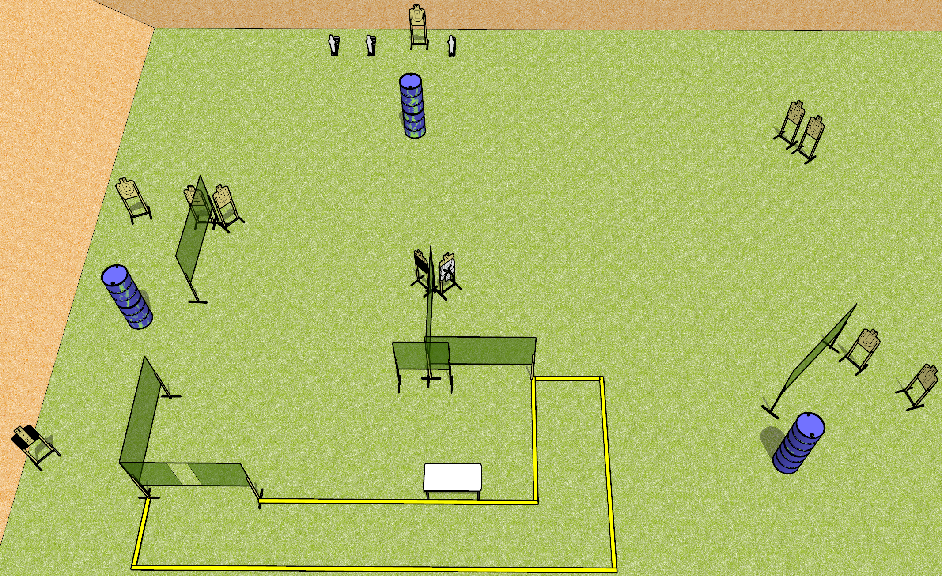
 | Dothan Gun Club – USPSA Match Get Em And Go Course Designer : Drew Coleman
Round Count 25 rounds 11 USPSA 3 mini poppers
Equipment List 12 wall feet Table 1 tux, 1 50%, 10 targets (9 + 1 NS)

Slide 6
Get Em And Go
Written Stage Briefing
Scoring: Comstock
Rounds: 25
Targets: 11 USPSA, 3 steel
Start Position: Anywhere completely outside the shooting area, toes touching rear fault line. Firearm is unloaded and unpropped, trigger guard on mark. All magazines to be used on stage on table.
Stage Procedure: on the audible start signal, engage targets as they become available from within the shooting area.

Slide 7
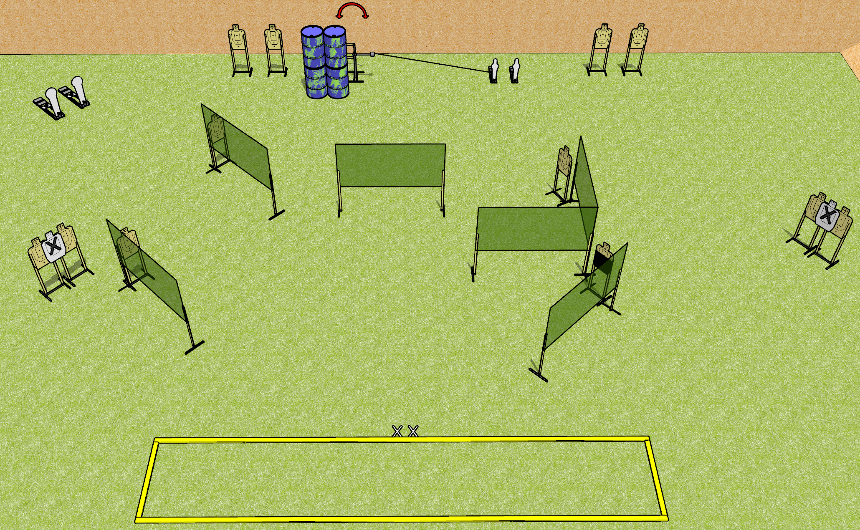
 | Dothan Gun Club – USPSA Match On Stage Course Designer : Drew Coleman
Round Count 30 rounds 13 USPSA 2 colt, 2 mini
Equipment List 11 wall feet Swinger + Activator Shooting area is 30’ wide 1 50%, 14 targets (12 + 2NS)

Slide 8
On Stage
Written Stage Briefing
Scoring: Comstock
Targets: 13 USPSA, 4 steel
Rounds: 30
Handgun start position: feet on X’s, facing down range, wrists below belt. Handgun is loaded and holstered.
PCC start position: feet on X’s, facing down range, stock on belt. Carbine is loaded, safety on.
Stage Procedure: on the audible start signal, engage targets as they become available from within the shooting area. The swinger is activated by P3 and remains visible at rest.

Slide 9
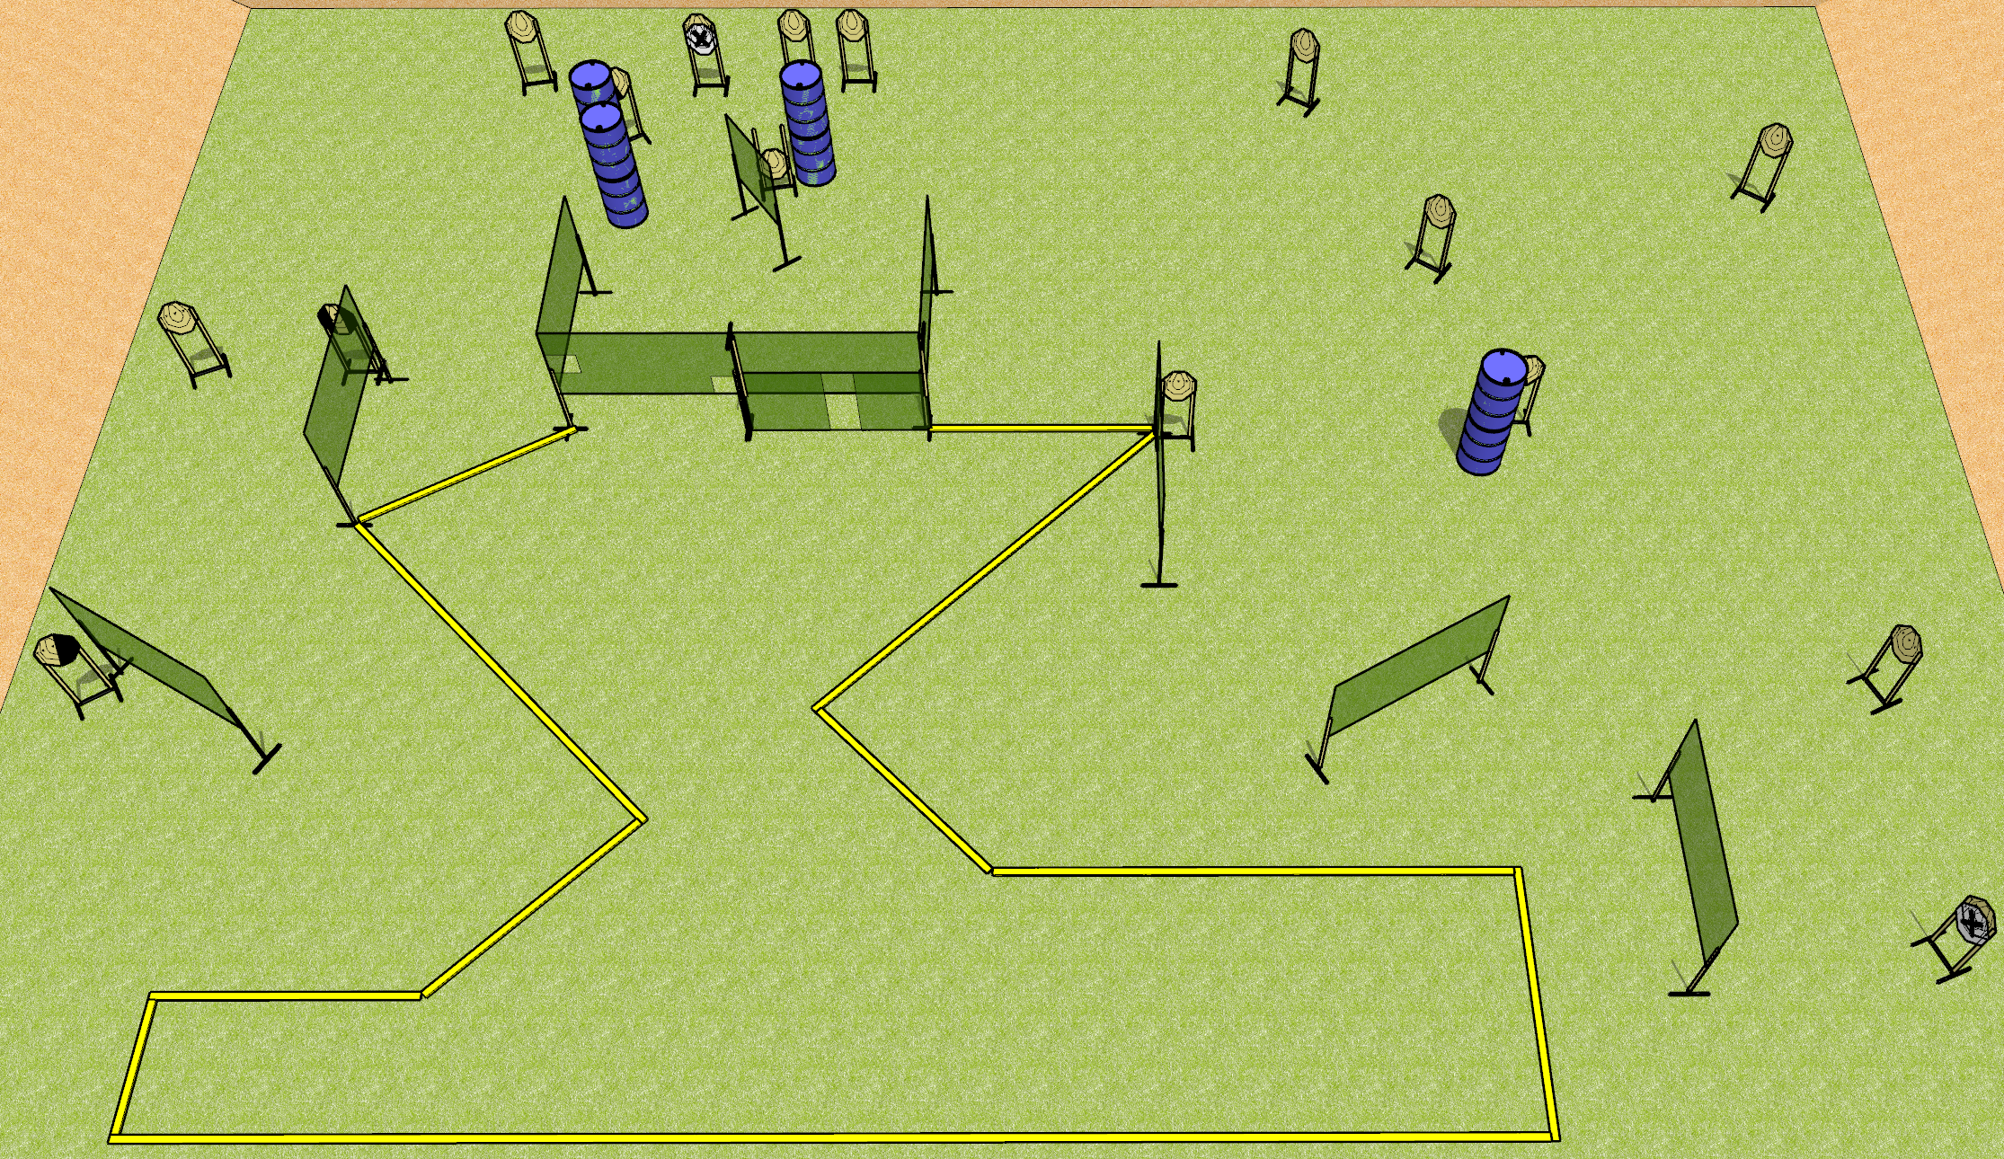
 | Dothan Gun Club – USPSA Match The World Is Not Enough Course Designer : Drew Coleman
Round Count 32 rounds 16 IPSC
Equipment List 17 wall feet 1 tux, 1 left + 1 right diag, 15 targets (13 + 2NS) All the long fault lines are 10 foot

Slide 10
The World Is Not Enough
Written Stage Briefing
Scoring: Comstock
Rounds: 32
Targets: 16 IPSC
Handgun start position: anywhere inside the shooting area, wrists below belt. Handgun is loaded and holstered.
PCC start position: anywhere inside the shooting area, stock on belt. Carbine is loaded, safety on.
Stage Procedure: on the audible start signal, engage targets as they become available from within the shooting area.

